Slide 1
Deep Learning and Neural Networks
Aberdeen Institute of Data Science and
Artificial Intelligence
South China Normal University
Fall 2024
Teacher:
Engr. Dr. Farah Deeba Memon
Dr.deeba@scnu.edu.cn

Slide 2
Academic Background of the Course
Deep Learning and Neural Networks" is a mandatory professional course for undergraduate students majoring in Artificial Intelligence.
This course covers two parts:
Artificial Neural Networks
Deep Learning
both of which are models and methods widely recognized and applied in the field of artificial intelligence today.
Building on the foundation of specialized academic knowledge, this course gradually introduces students to professional technical applications, equipping them with the ability to solve real-world problems using the knowledge they have acquired.

Slide 3
Purpose and Significance of the Course:
Through the course, students will master the theory, models, methods, and application of modern engineering tools in artificial neural networks and deep learning, keep abreast of the forefront of the field, and cultivate the ability to apply these methods and technologies to solve practical problems.
Additionally, the course aims to foster students' abilities to inquire actively, learn proactively, and develop innovative thinking habits, thus preparing them with the basic skills needed for conducting scientific research.

Slide 4
Main Content:
The course focuses on the
Basic Theories,
Methods,
Models,
Applications of Artificial Neural Networks and Deep Learning
It emphasizes the explanation of practical examples related to these technologies and the use of related engineering tools.

Slide 5
Course Features and Ideological and Political Education:
On the basis of helping students establish a basic understanding of neural networks and deep learning, a "goal-driven" teaching method is adopted to guide students to start with problems, learn to analyze issues, and utilize their knowledge to solve problems.
During the teaching process, by discussing the origins, development, and future directions of neural networks and deep learning, students are guided to contemplate pathways for technological reform, inspiring them to learn actively, explore boldly, innovate, and solidify their dedication to diligent study and service to the nation.

Slide 6
Teaching and Assessment Methods:
The course is student-centered and teacher-led, utilizing a variety of teaching methods including classroom teaching video demonstrations, and programming experiments.
The course assessment consists of continuous assessment, laboratory performance, and a final examination, accounting for 20%, 30%, and 50% of the final grade, respectively.
Continuous assessment includes homework and classroom exercises (20%);
Laboratory performance includes lab checks and lab reports (30%);
The final examination is an open-book written test (50%).

Slide 7
Class Room Teaching :
• Classroom Teaching:
Utilize PowerPoint presentations and online resources featuring text, images, and videos.
Ideological and Political Education:
By understanding the current state of deep learning development and applications both domestically and internationally, students recognize the importance of the course, develop a mindset of contributing to the nation's concerns, and enhance the motivation for active learning.
Lectures: Concept introduction and theoretical background.
Hands-On Labs: Practical implementation of models using frameworks like TensorFlow and PyTorch.
Group Projects: Collaborative work on real-world AI problems.

Slide 8
Course Overview
Title: Teaching Design for Deep Learning and AI
Course Objectives:
Understand foundational concepts in Deep Learning and Artificial Intelligence.
Develop skills to implement and evaluate AI models.
Prepare students for research or industry roles involving AI technologies.

Slide 9
Teaching Content & Schedule:
Course Outline:
Week 1-2: Introduction to AI and Machine Learning Basics
Week 3-5: Neural Networks and Deep Learning Fundamentals
Week 6-8: Advanced Deep Learning Architectures (CNNs, RNNs, GANs)
Week 9-11: AI Applications (NLP, Computer Vision, Robotics)
Week 12-14: Ethical Considerations and Future Trends in AI
Week 15-16: Project Work and Course Review

Slide 10
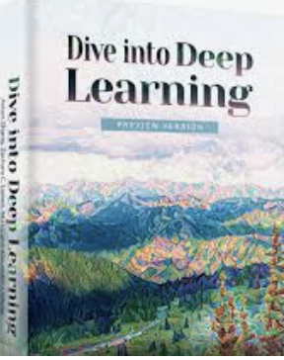


Recommended Books:
Primary Textbooks: Deep Learning by Ian Goodfellow, Yoshua Bengio, and Aaron Courville.
Artificial Intelligence: A Modern Approach by Stuart Russell and Peter Norvig.
Supplementary Materials: Research papers, online tutorials, and technical blogs.

Slide 11
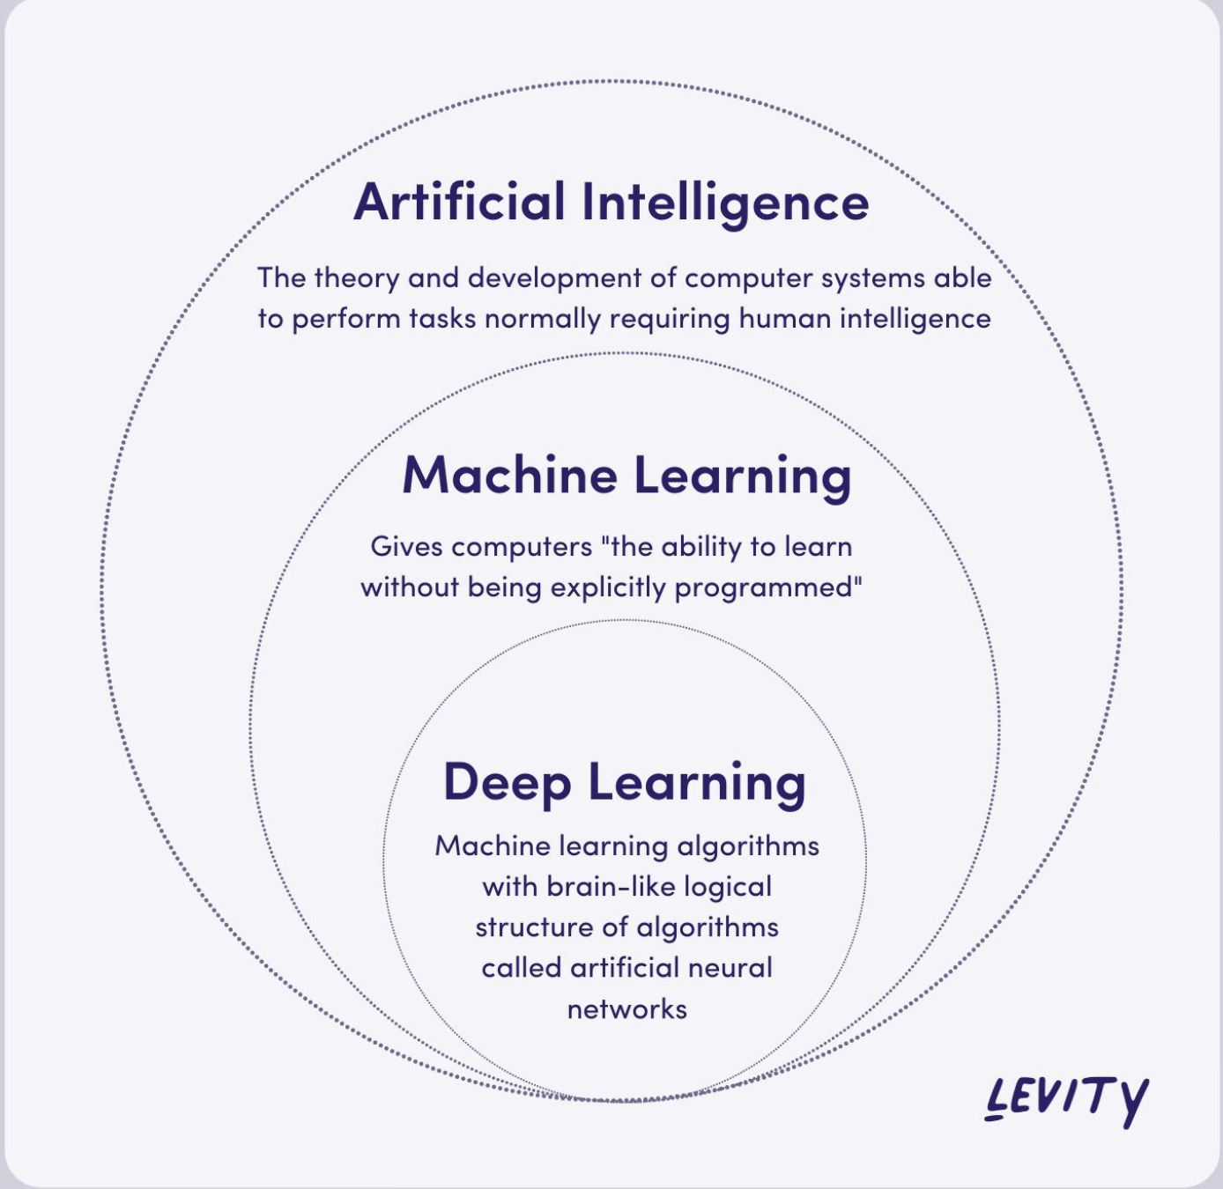
Artificial Intelligence:
Intelligence is the ability to process information which will inform your future decision-mak abilities.
Artificial intelligence is simply the ability for us to give computers that same ability to process information and inform future decisions

Slide 12
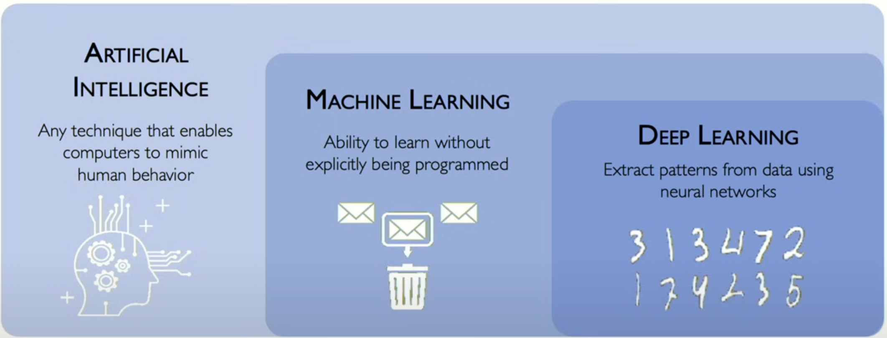
What is Machine Learning
Machine learning is simply a subset of artificial intelligence,
The way you should think of machine learning is just as the programming ability or let's say even simpler than that
Machine learning is the science of of trying to teach computers how to do that processing of information and decision making from data.
So instead of hardcoding some of these rules into machines and programming them like we used to do in software engineering classes now we're going to try and do that processing of information and informing a future decision making abilities directly from data.

Slide 13
What is Deep Learning
Deep learning is simply the subset of machine learning which uses neural networks to do that it uses neural networks to process raw pieces of data now unprocessed data and allows them to ingest all of those very large data sets and inform future decisions.

Slide 14
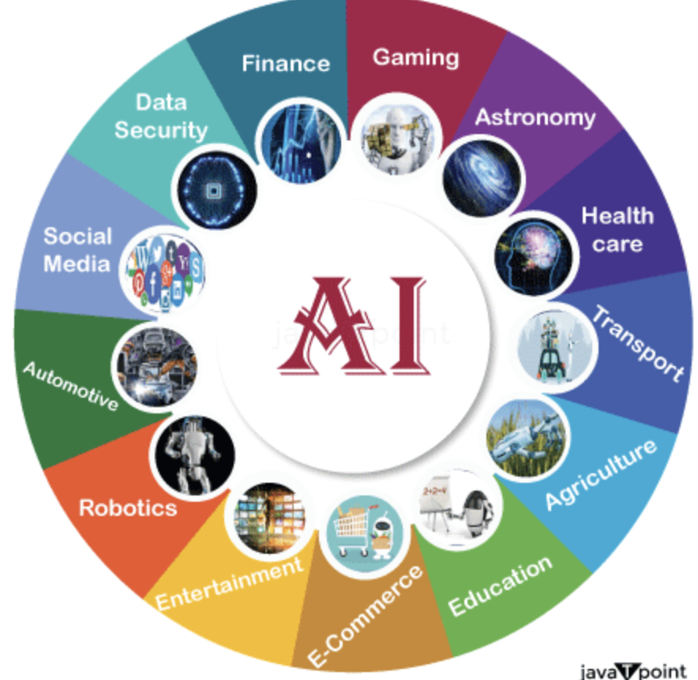
Applications of AI

Slide 15
What is a Neural Network?
Neural networks, also called artificial neural networks (ANNs) or simulated neural networks (SNNs), are a subset of machine learning and are the backbone of deep learning algorithms.
They are called “neural” because they mimic how neurons in the brain signal one another.
The neural network is a set of algorithms that attempts to identify underlying relationships in a dataset using a method that mimics how the human brain works. It refers to a system of neurons that can be artificial or organic in nature.

Slide 16
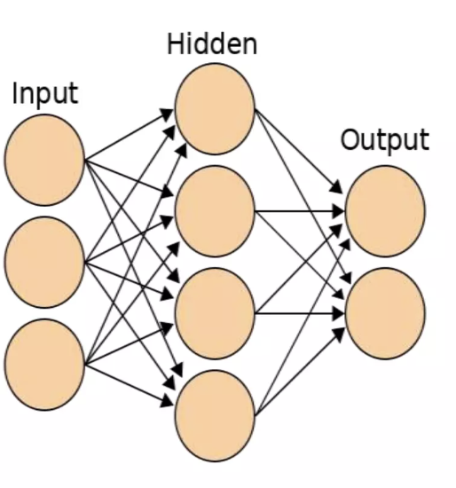
How Neural Network works
The Neural network process begins with input data which is further processed to provide the required output.
It uses structured data to get the output.
The perceptron, often known as a neuron, is a basic neural network component, and it learns and defines data using the supervised learning method.
This process comprises three layers:
Input layer
Hidden layer
Output layer

Slide 17
How Neural Network works
The input layer receives the data numerically; then, the hidden layer constitutes the intermediary node that divides the layer into boundaries by executing computations.
Finally, the output layer exhibits the desired output.
This structure is known as a simple neural network, and layers of this network are connected by the nodes, further forming a network.

Slide 18
Components of Neural Networks
There are different types of neural networks but they always consist of the same components: neurons, synapses, weights, biases, and functions.
Neurons
A neuron or a node is a basic unit of neural networks that receives information, performs simple calculations, and passes it further.

Slide 19
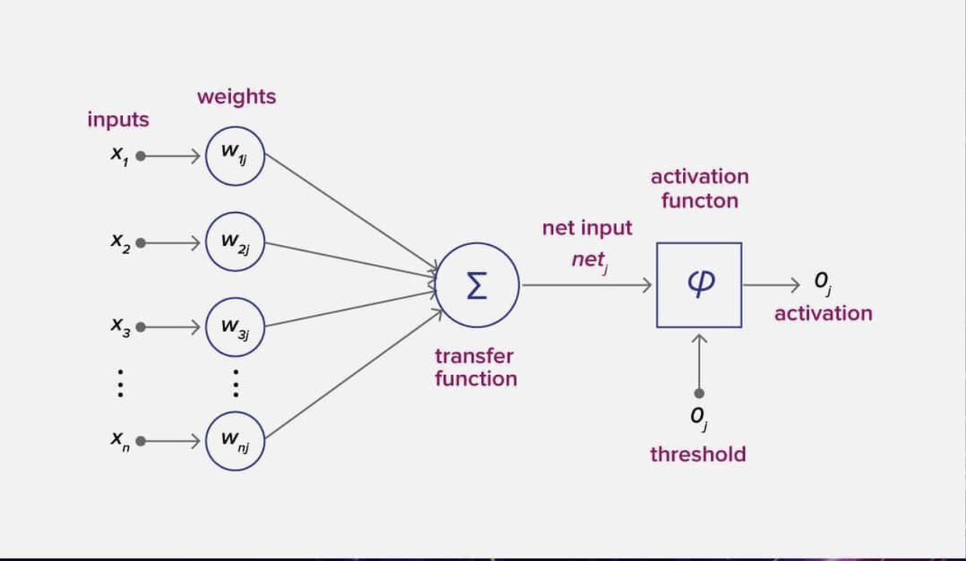
Example
Every neuron processes input data to extract a feature.
Let’s imagine that we have three features and three neurons, each of which is connected with all these features.
Each of the neurons has its own weights that are used to weight the features.
During the training of the network, you need to select such weights for each of the neurons that the output provided by the whole network would be true-to-life.
To perform transformations and get an output, every neuron has an activation function.

Slide 20
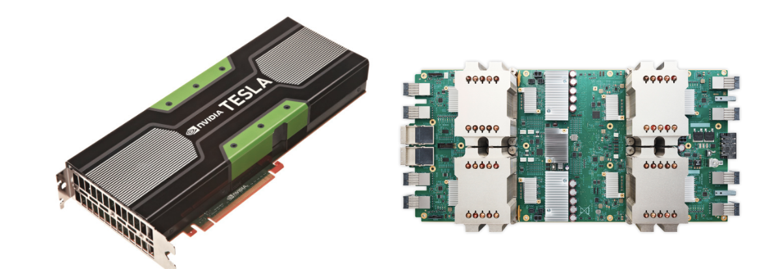
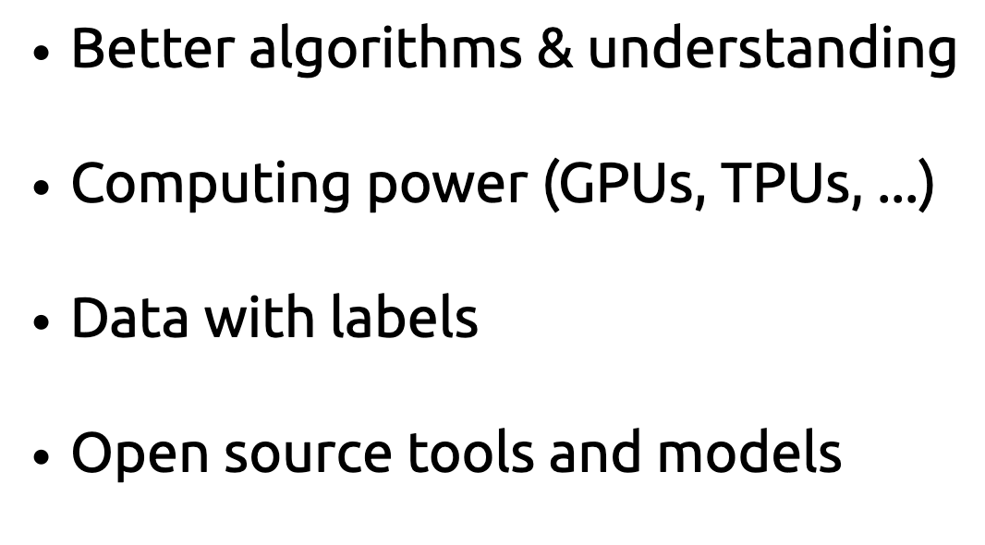
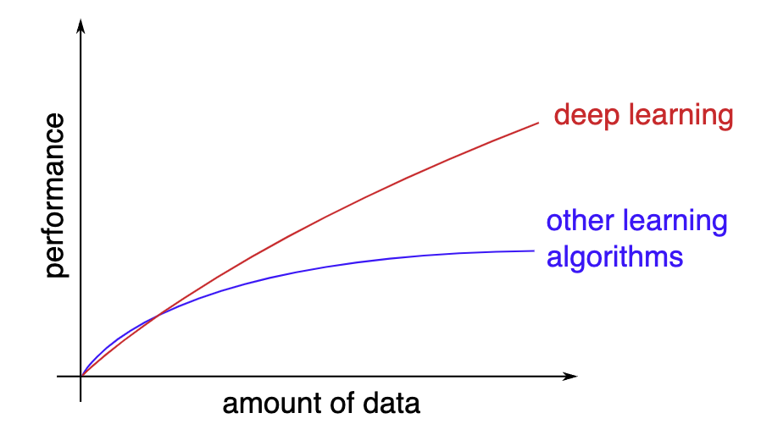
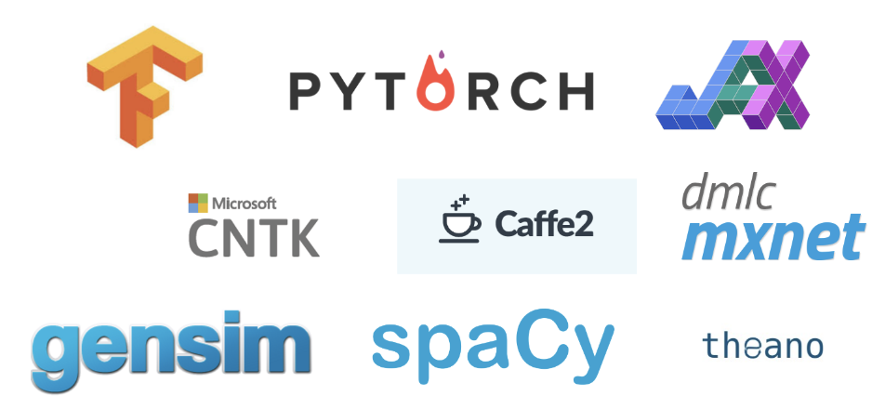
Why Deep Learning

Slide 21
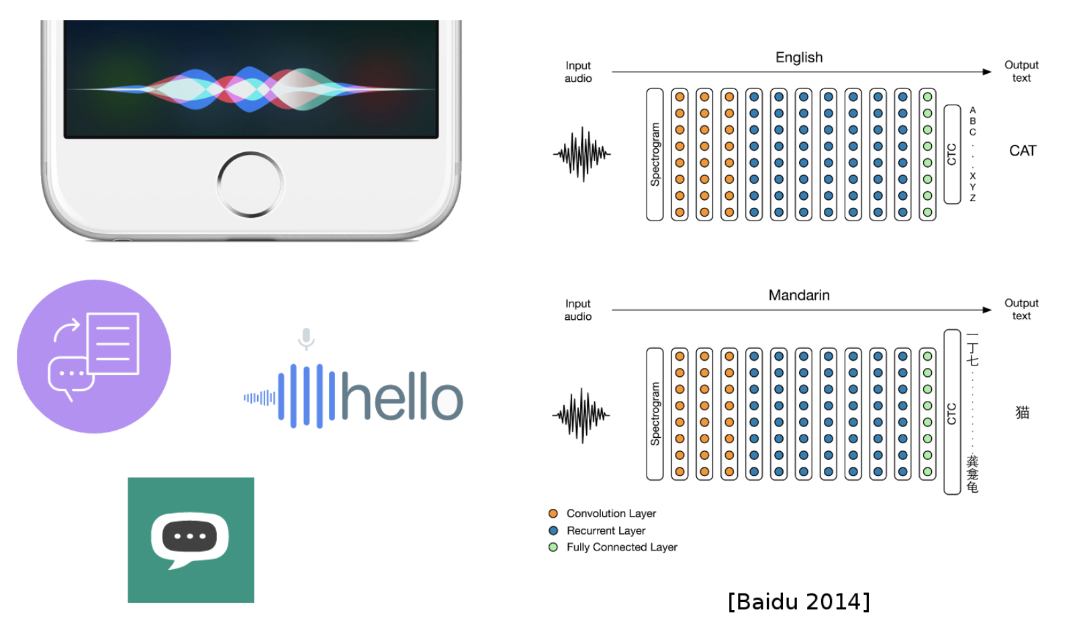
Deep Learning Today: Speech-to-Text

Slide 22
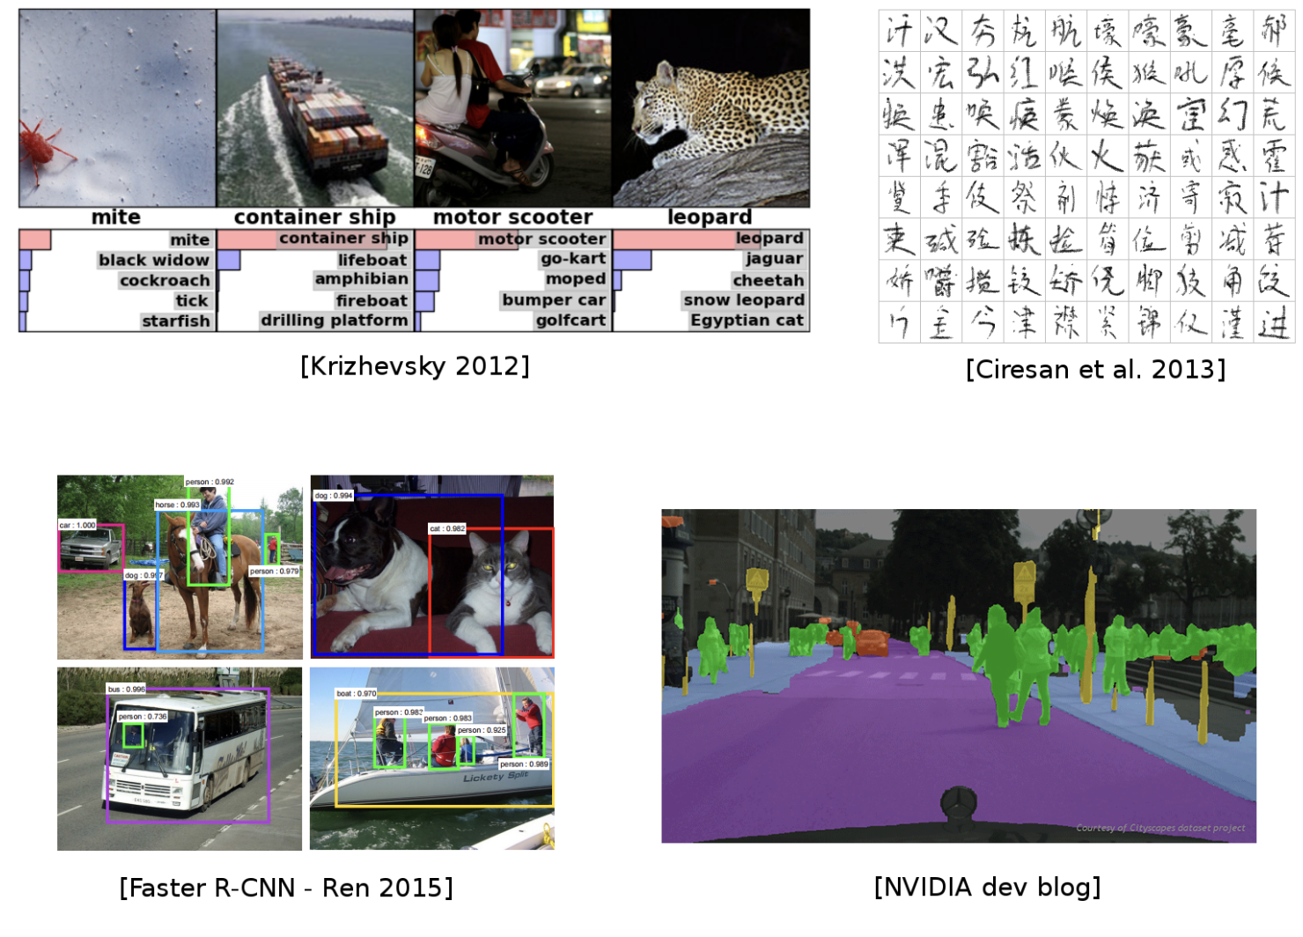
Deep Learning Today : Vision

Slide 23
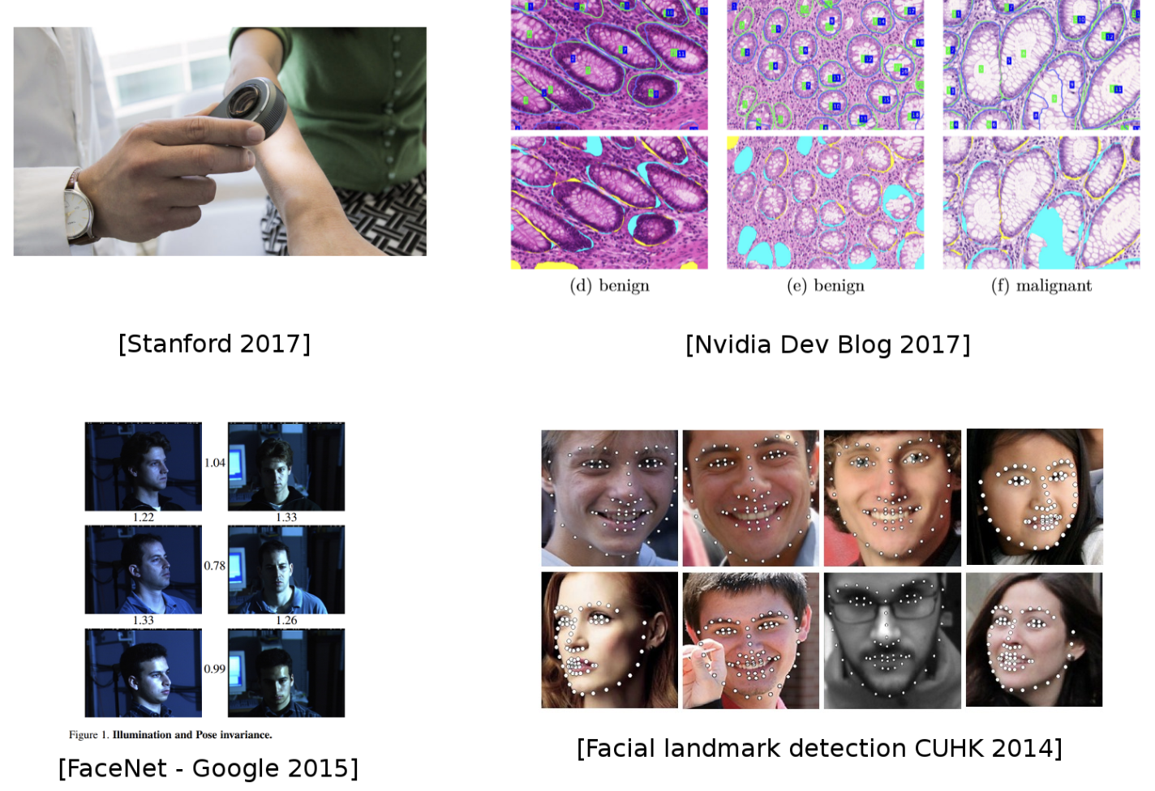
Deep Learning Today : Vision

Slide 24
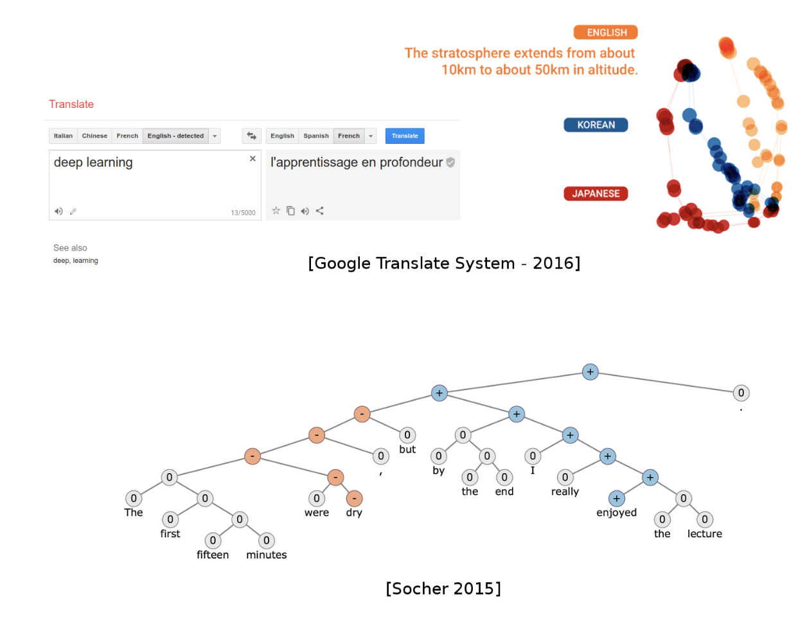
Deep Learning Today : NLP

Slide 25
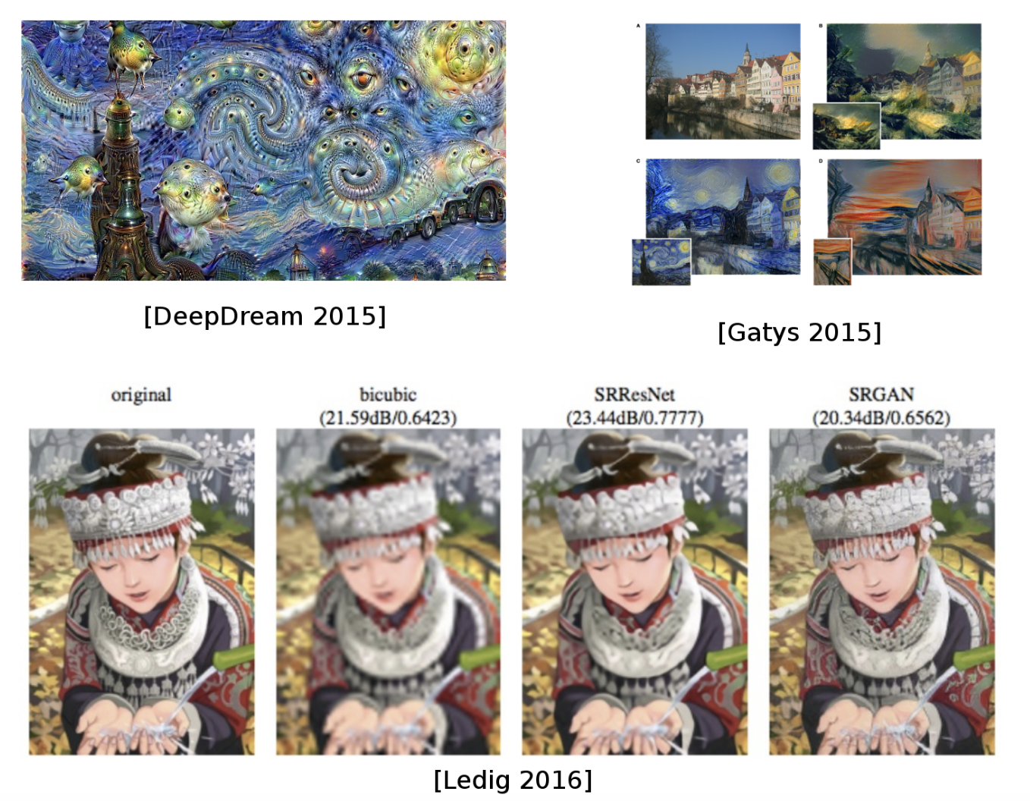
Deep Learning Today : Image Translation

Slide 26


